Slide 1


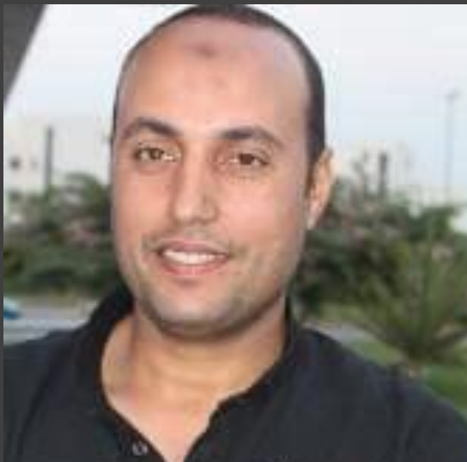

Diar oracle ERP-SCM-EBS project
Supervised by
Eng. Mohamed Samir

Slide 2
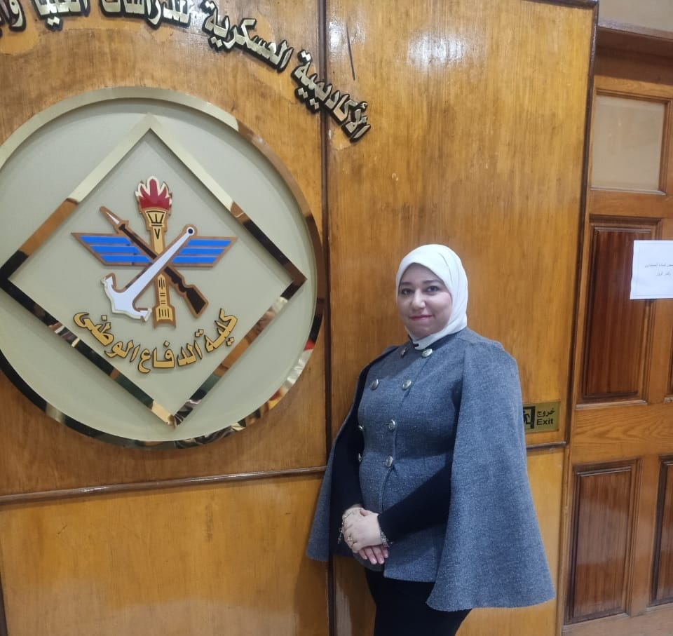



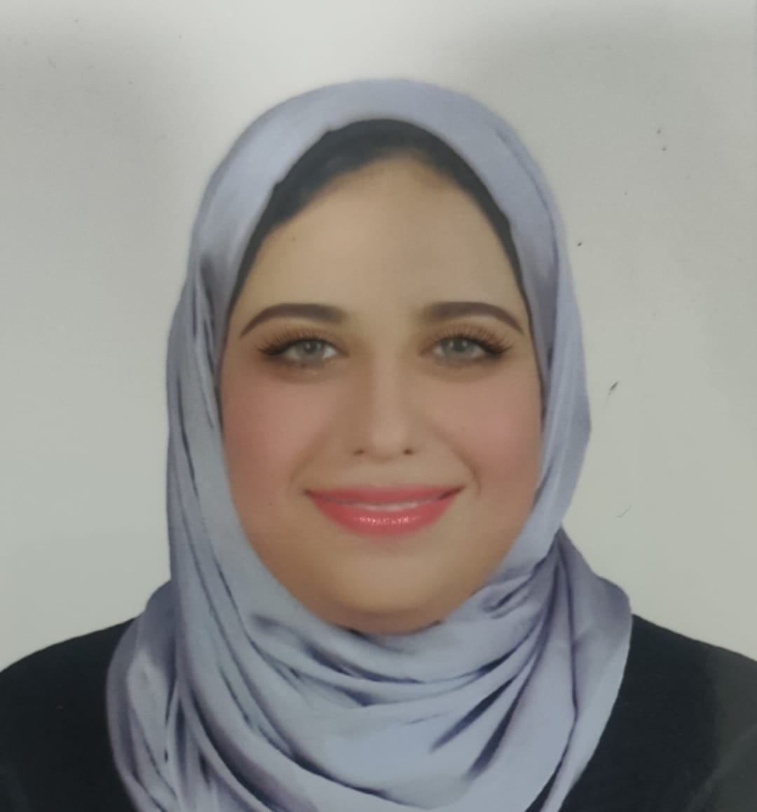
Out Team
Eng. Asmaa Sobhy
Eng. Ahmed Khedr
Abdelrahman Elshorbagy
Eng. Ahmed Zaky
Dr. Mai Taher
Inventory Planning Manager at ELARABY Group
Sales Business Developer
a pharmacist, is the Training and Development Officer at the Medical Administration in El-Bagour and a former Supply Chain Manager.
Civil engineer,
Urban Planning Engineer at Menoufia Governorate
a Procurement Manager with over 10 years of experience in strategic sourcing, supplier management, and supply chain optimization

Slide 3

Introduction
Oracle E-Business Suite (EBS)
is a comprehensive suite of integrated business applications designed to help organizations manage their business processes efficiently.
For a manufacturing organization like Diar, Oracle ERP (Enterprise Resource Planning) and SCM (Supply Chain Management) modules within EBS offer robust solutions to streamline operations, enhance productivity, and improve decision-making.

Slide 4

Phases of project

Slide 5
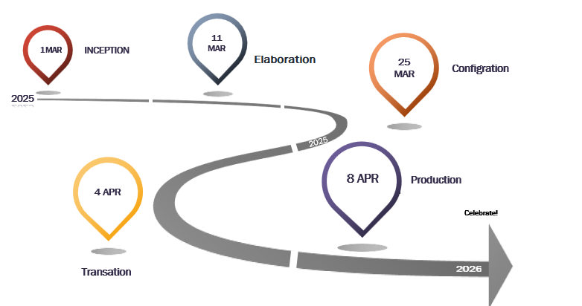

Slide 6

Inventory
1St phase of implementation

Slide 7
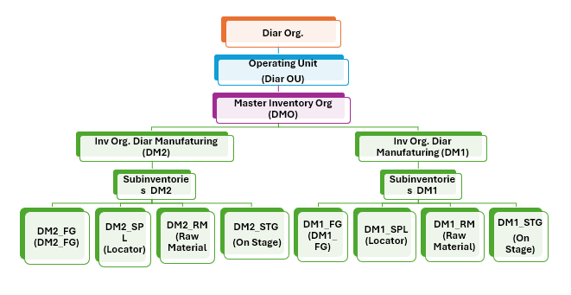
Diar Org. Structure

Slide 8
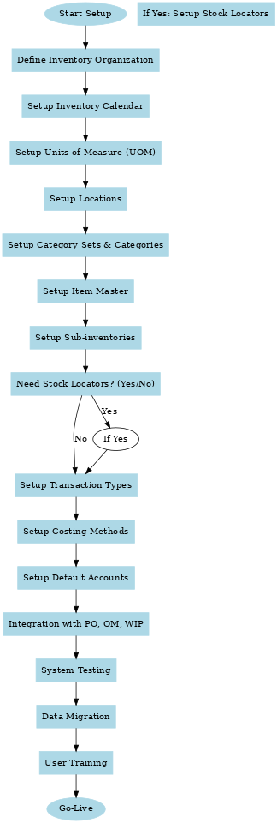
Inventory Module Flow Chart

Slide 9
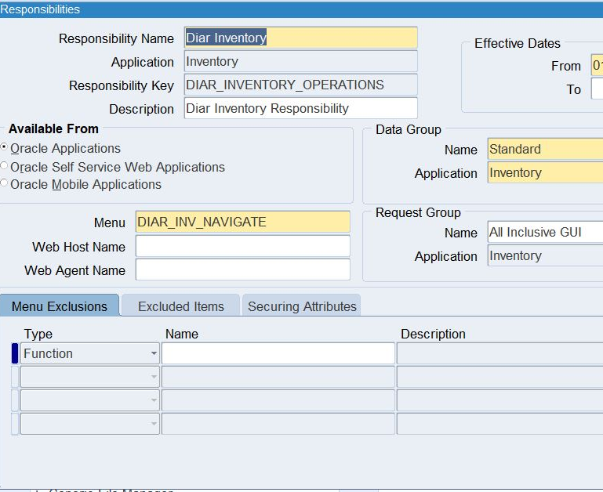
Create Responsibility
How
System Administrator -– Security --- Responsibility --- Define
Name
Diar Inventory

Slide 10
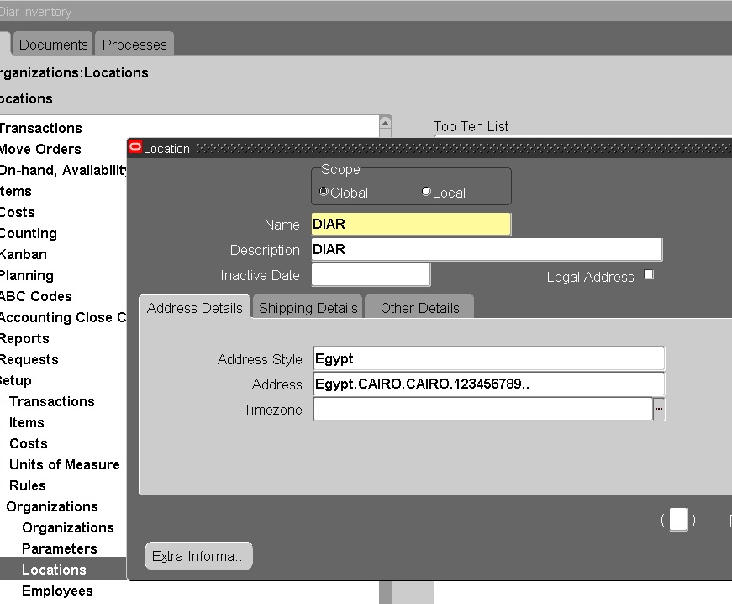
Create Location
In this step
Create locations of the org.
How | setup --- Organizations --- Location
Name | Diar Location

Slide 11
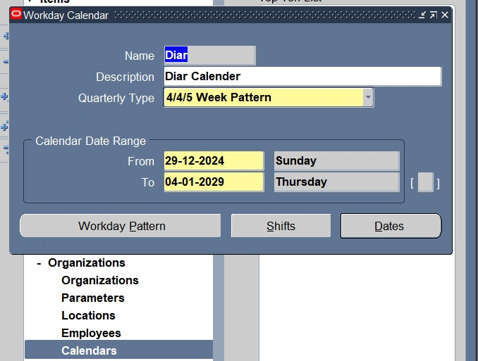
Workday calendar
Calender
How | setup --- Organizations --- Calendars

Slide 12
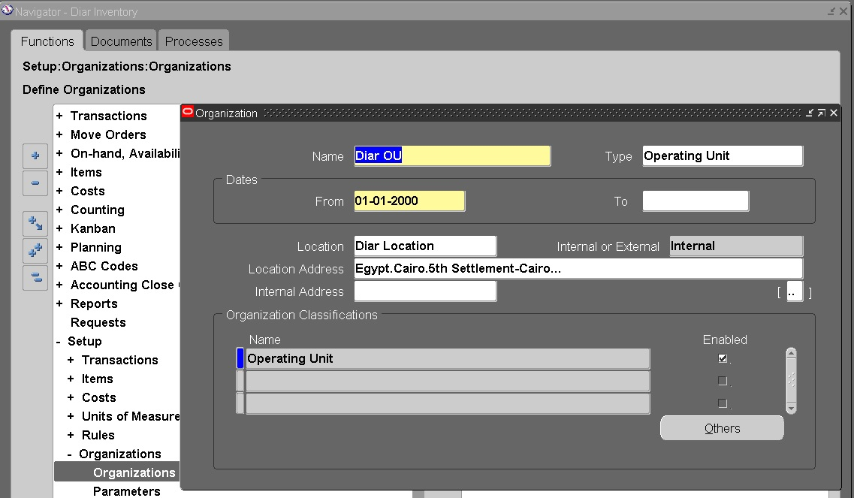
Create Operating Unit
How | setup --- Organizations --- Organizations
Name | Diar OU

Slide 13
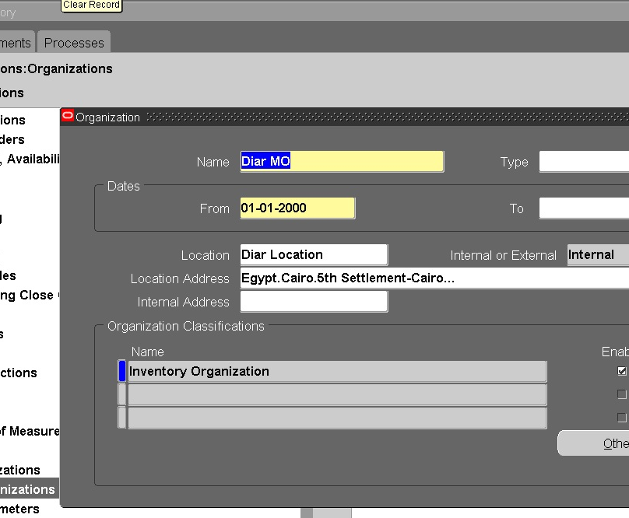
Create Master Organization
setup --- Organizations --- Organizations Name: Diar MO Code: DMO

Slide 14
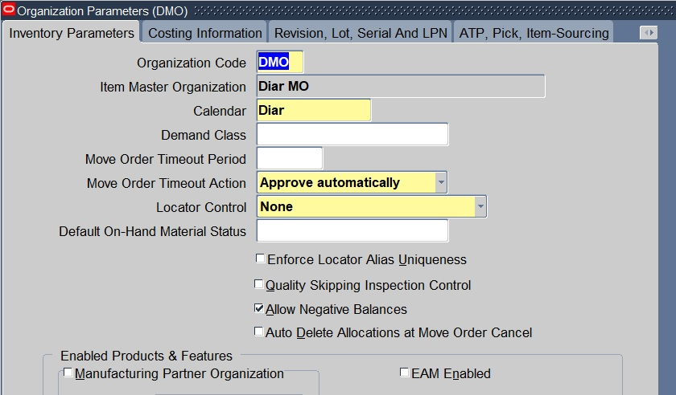
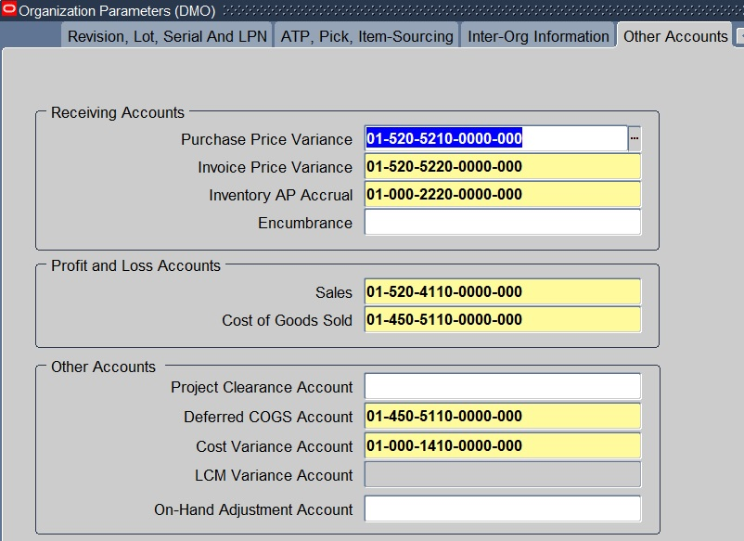
Create Master Organization

Slide 15
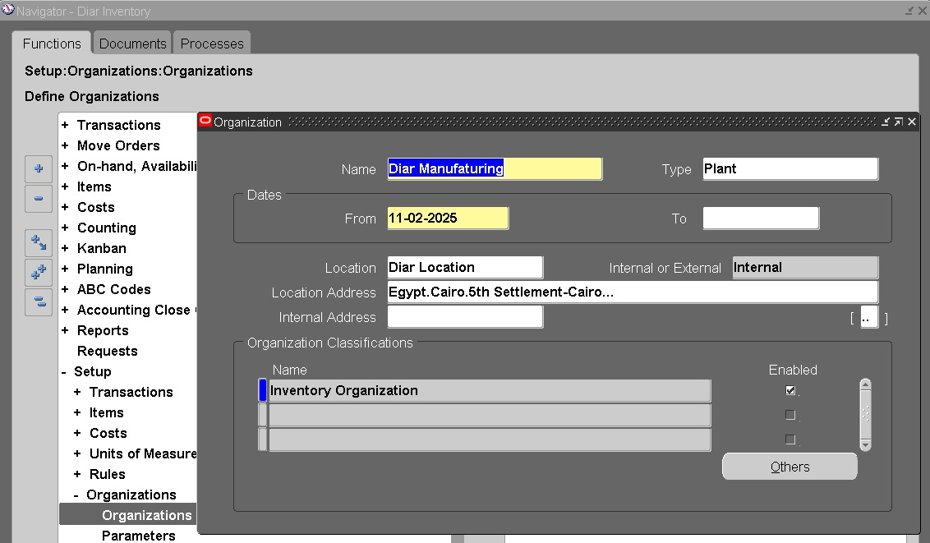
Create Inventory Organization
DM1 | Diar Manufaturing
DM2 | Diar Manufaturing2

Slide 16
Create Sub inventories
Sub inventories DM1
How | Setup --- Organizations --- Sub inventories
1 | DM1_STG | On Stage
2 | DM1_RM | Raw Material
3 | DM1_SPL | Locator
4 | DM1_FG | Finished Good
Sub inventories DM2
1 | DM2_STG | On Stage
2 | DM2_RM | Raw Material
3 | DM2_SPL | Locator
4 | DM2_FG | Finished Good

Slide 17
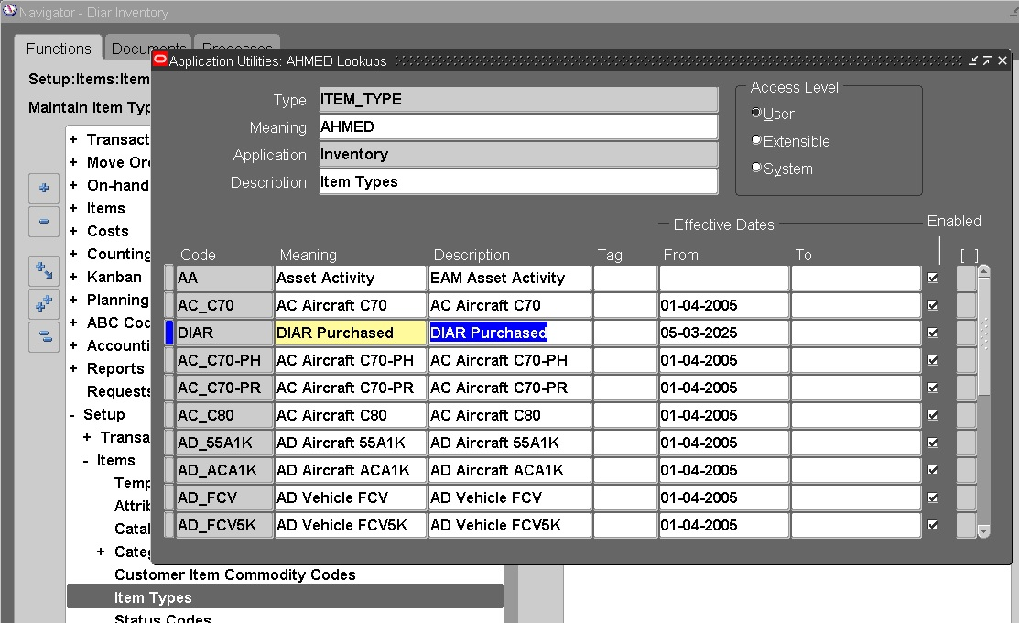
Create Item Type
Item Type
How | Setup --- Items --- Item Types |  |  | Diar

Slide 18
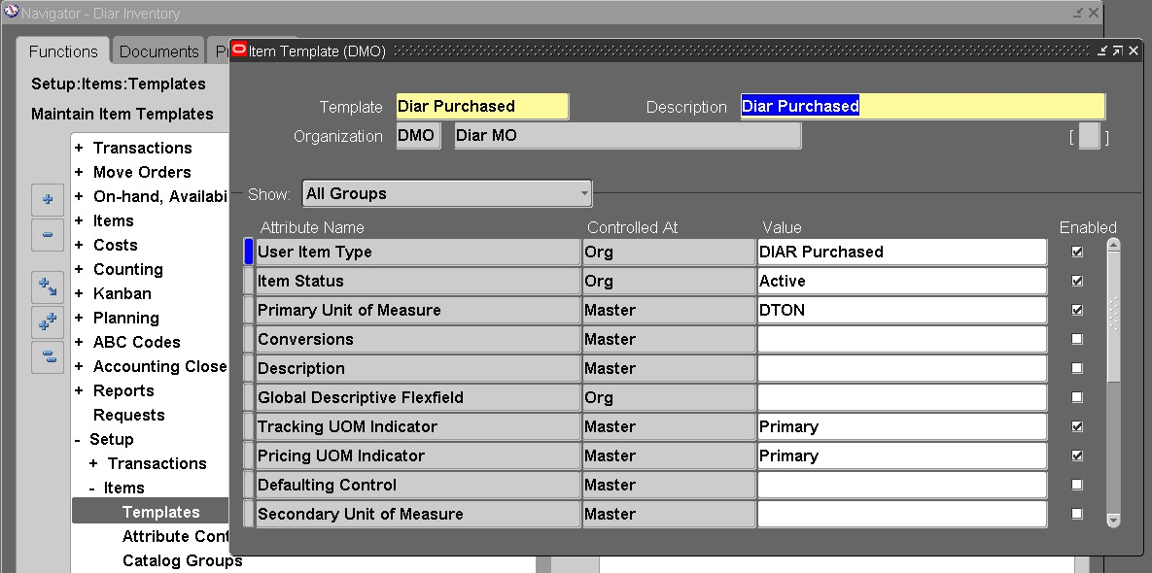
Create Item Template
Template
How | Setup --- Items --- Templates |  |  | (@Diar Purchased)

Slide 19
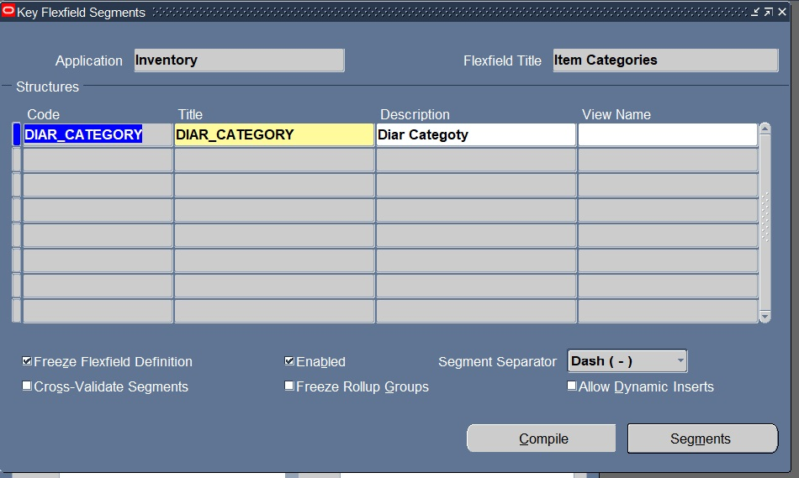
Create Item Category
1-Category Structure
Category Structure
How | Setup > Items > Categories > Category Key Flexfield > Segments

Slide 20
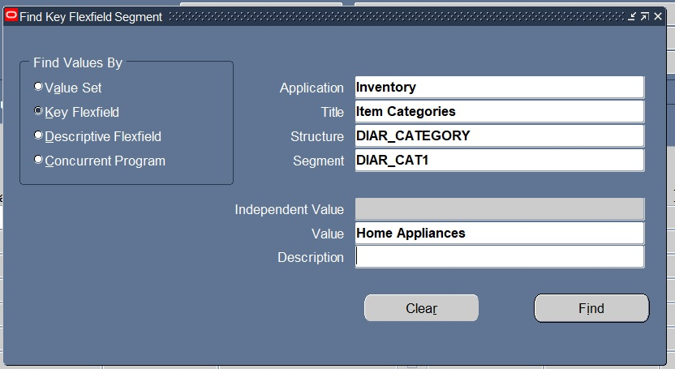
Create Item Category
2-Category Structure Values
Category Structure
How | Setup > Items > Categories > Category Key Flexfield > Values

Slide 21
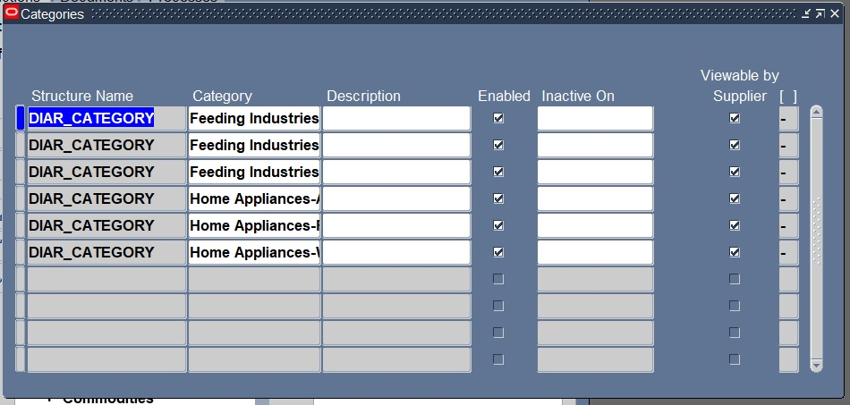
Create Item Category
3-Category Definition
Category Definition
How | Setup > Items > Categories > Categories > Category Codes

Slide 22
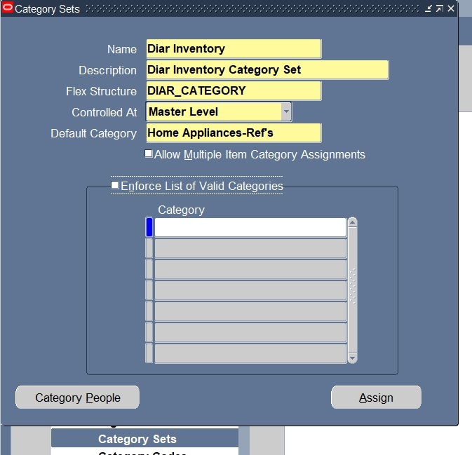
Create Item Category
4-Category Set
Category Definition
How | Setup > Items > Categories > Categories > Category Set

Slide 23
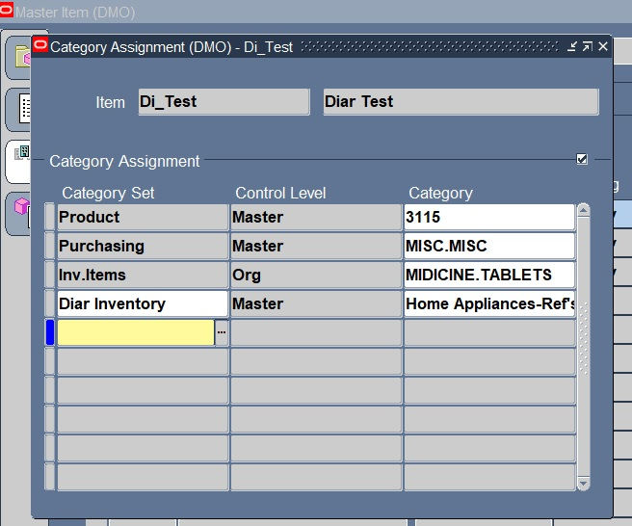
Create Item Category
5-Add Category to Item
Category Definition
How | Create Master Items and Click Tools > Categories

Slide 24
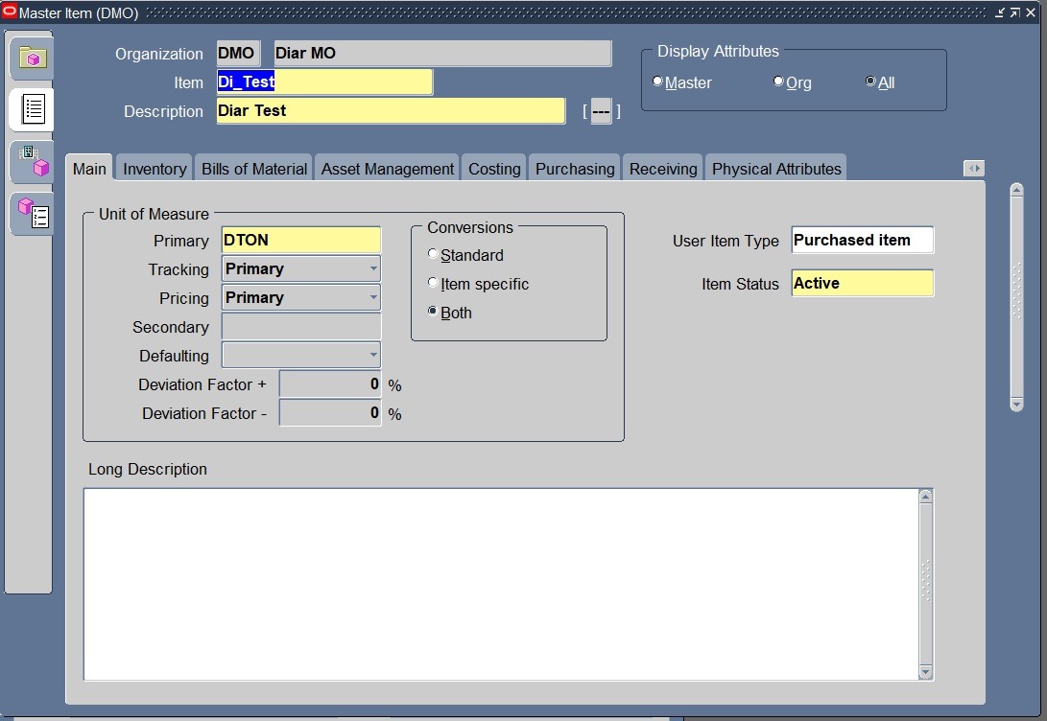
Create Item
Items --- Master Items

Slide 25
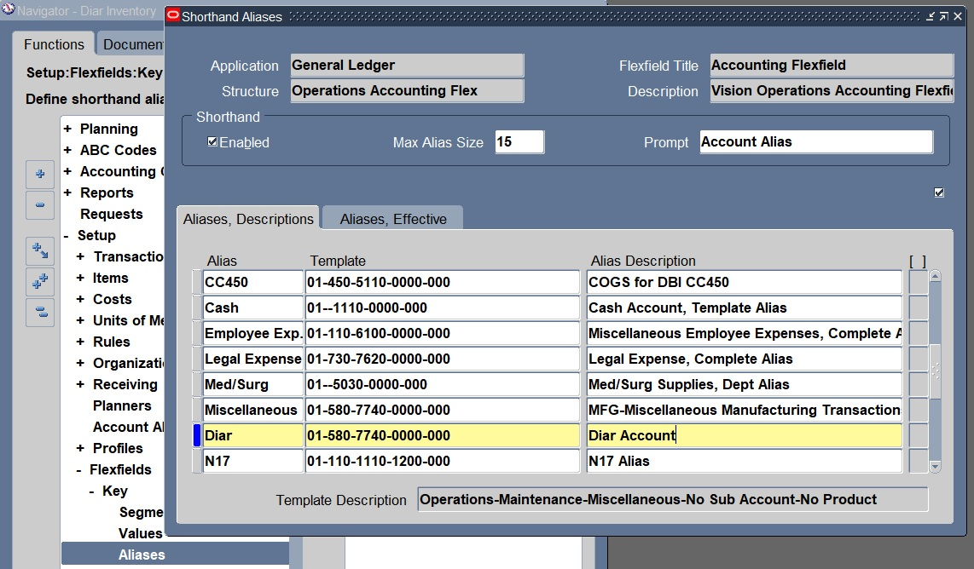
Create Shorthand Aliases
Setup > Flexfields > Key > Aliases

Slide 26
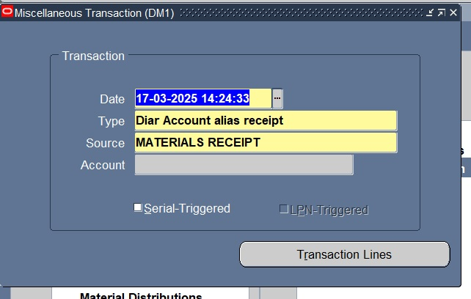
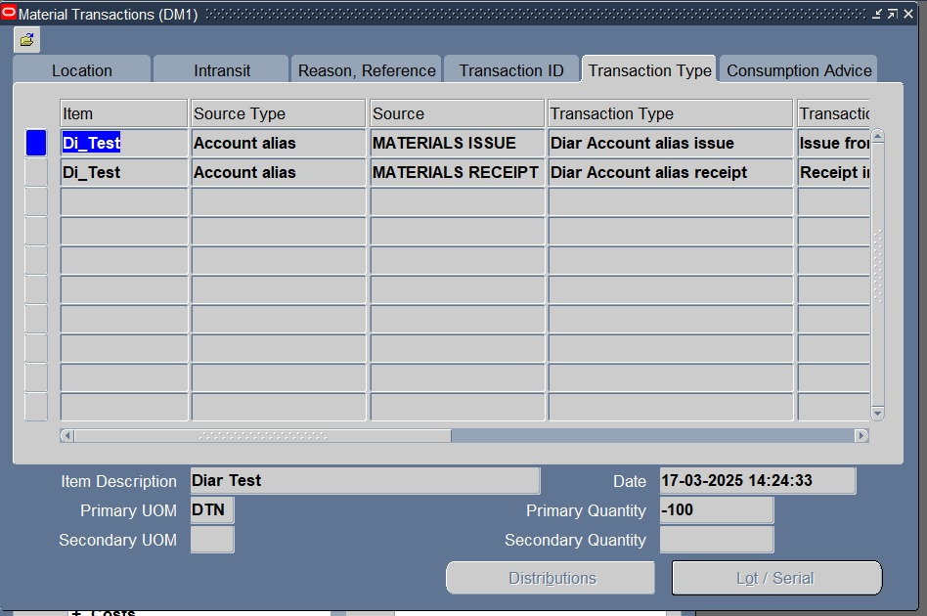
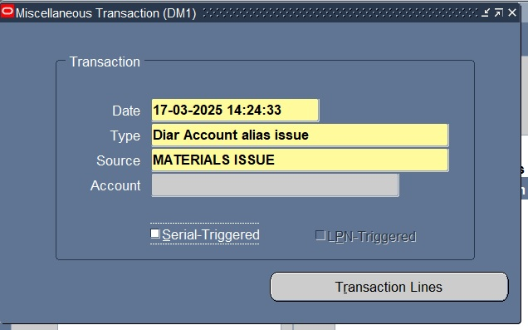
Account Alias, Receipt & Issue
Account Alias: Receipt & Issue
Transactions > Miscellaneous Transaction

Slide 27
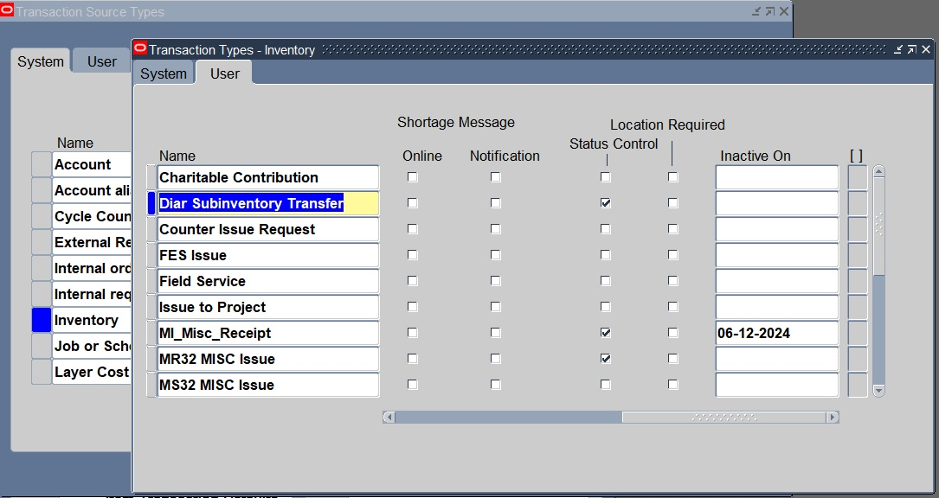
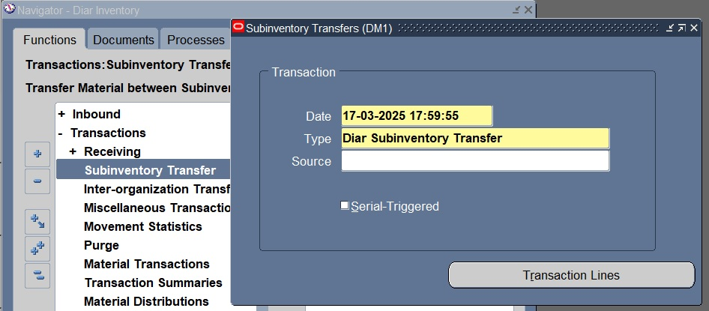
Sub inventory Transfer
Create Sub inventory Transaction
Setup --- Transactions --- Source Types … Then Select Inventory.
- Do Sub inventory Transaction
Transactions --- Sub Inventory Transfer

Slide 28

Purchasing
2nd phase of implementation

Slide 29
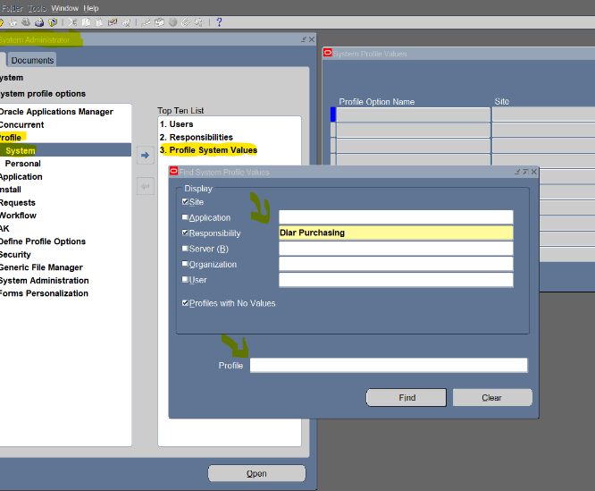
Responsibility
SYSTEM ADM ---SECURITY ---Responsibility --- define
Code: Diar purchasing

Slide 30
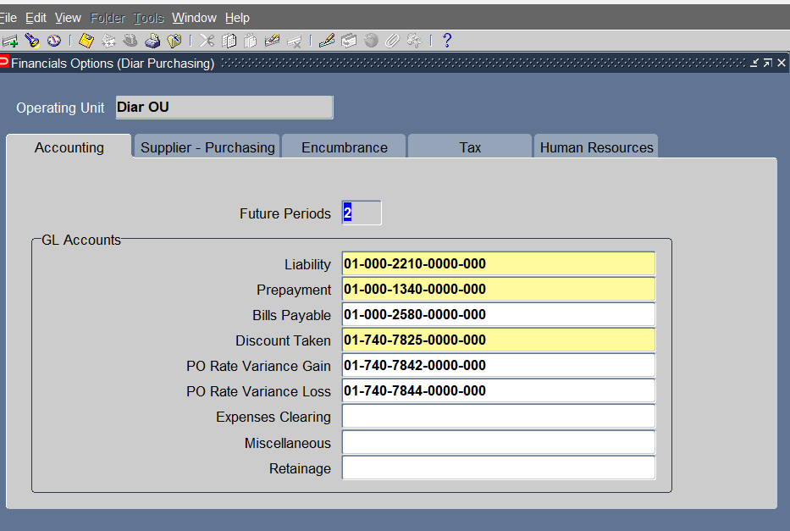
Financials Options
Purchasing --Setup --- Organizations --- Financial Options

Slide 31
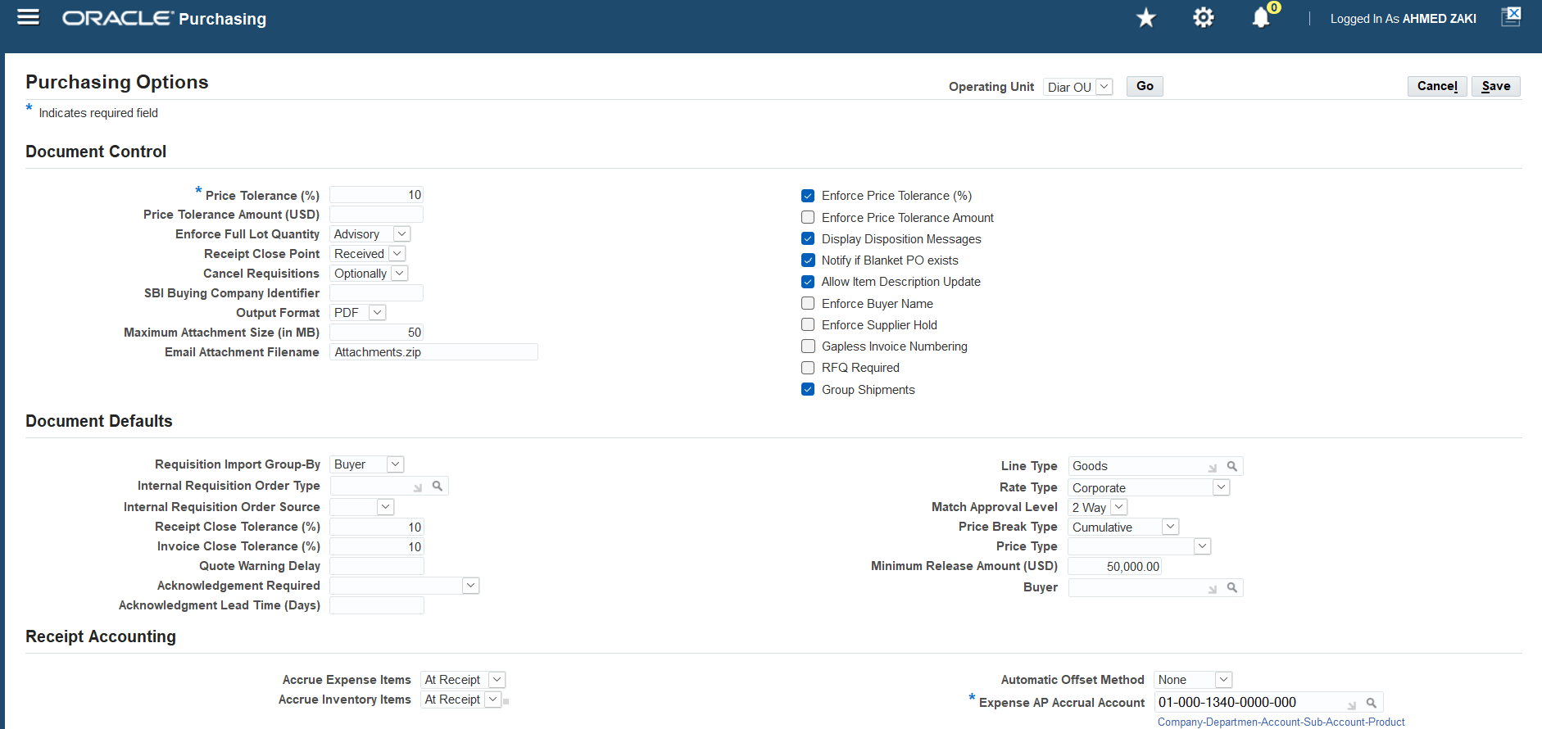
Purchasing Options
Purchasing --Setup --- Organizations --- Purchasing Options

Slide 32
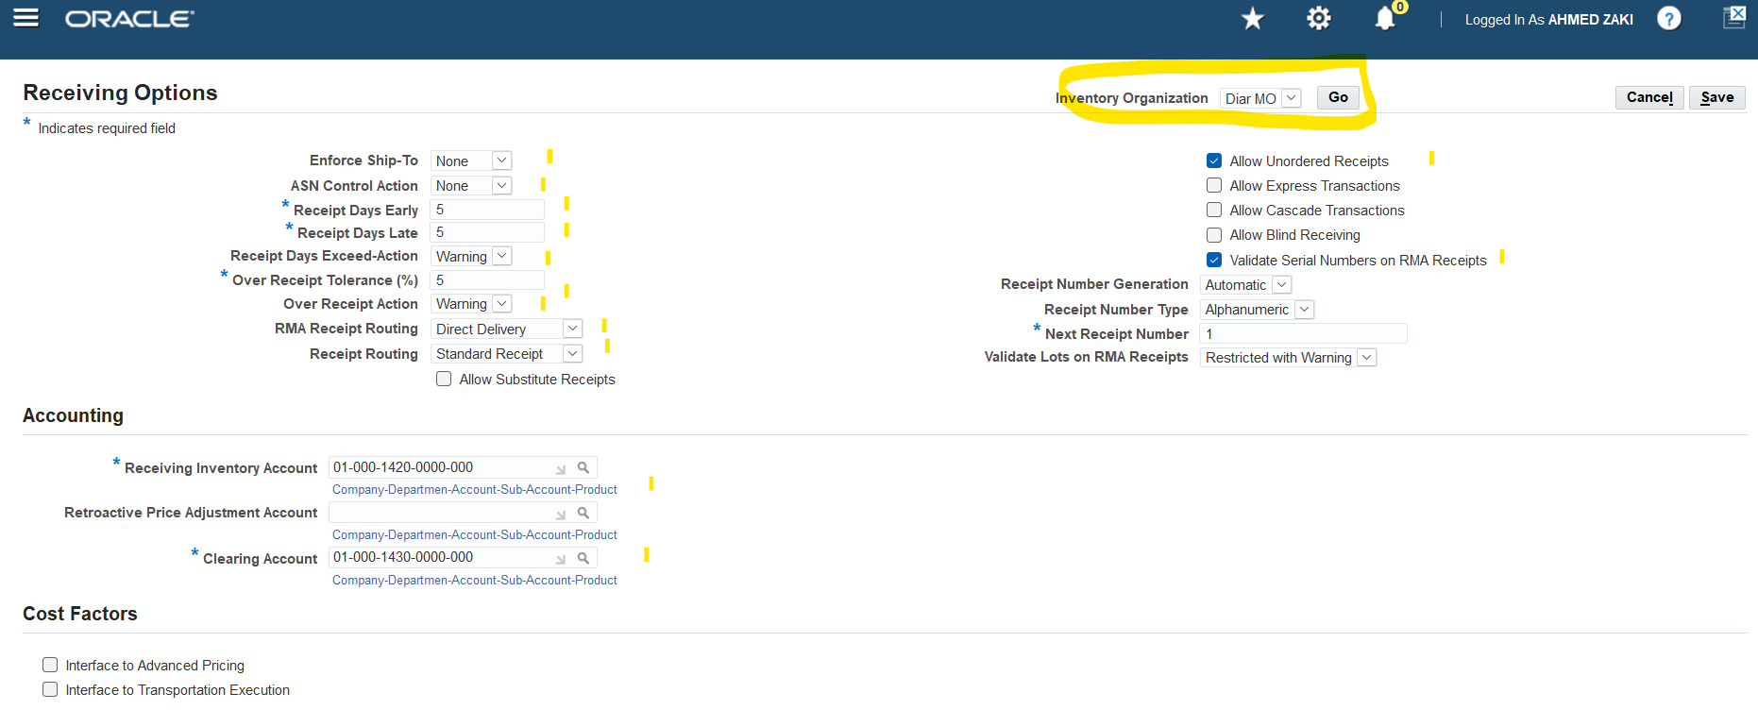
Receiving Options
Purchasing --Setup --- Organizations --- Receiving Options

Slide 33
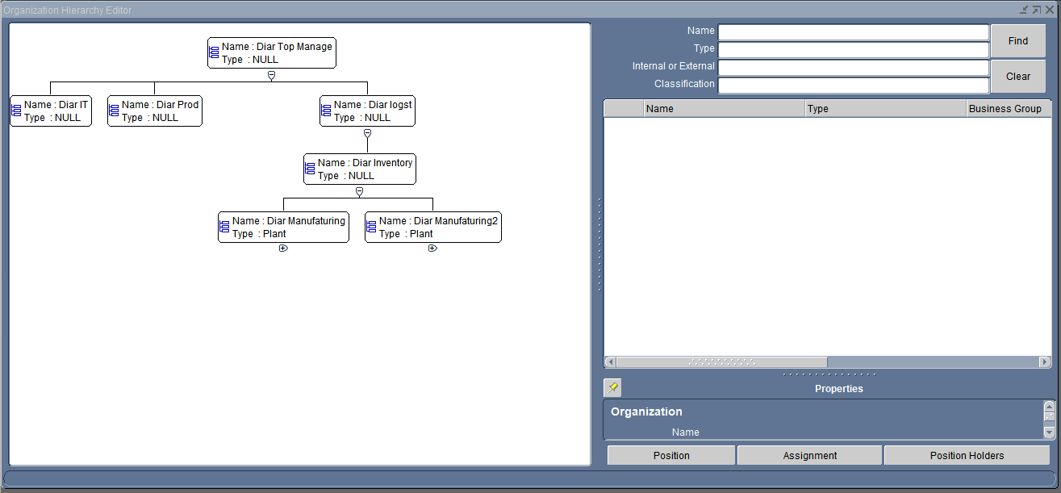
Define HR Organization
setup --- Organizations --- Organizations--HR ORG.
create: Diar Top Manage, Diar logst, Diar Prod, Diar IT
Diar inventory
assing: Diar Manifc.1,2
Global HRMS--org.--hierarchy

Slide 34
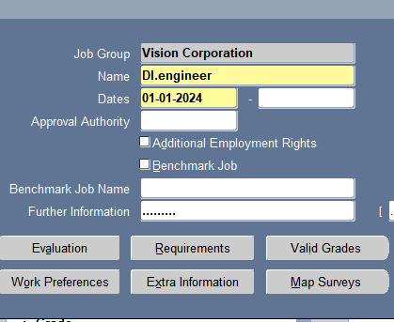
Define jobs
code | position
DI 001 | IT manager
DI 002 | IT egineer
Global HRMS—Work structure--job

Slide 35
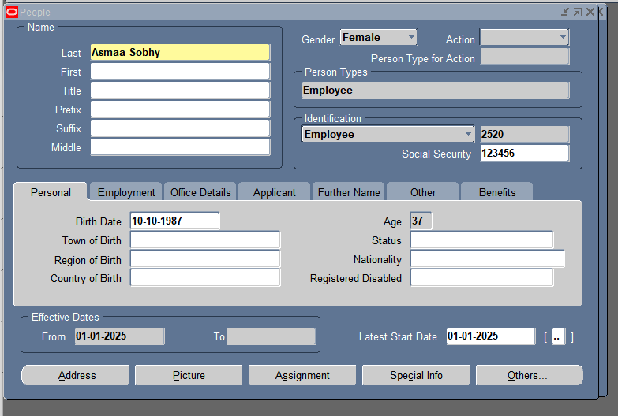
Define people and assign.
Global HRMS—people—enter and maintain

Slide 36
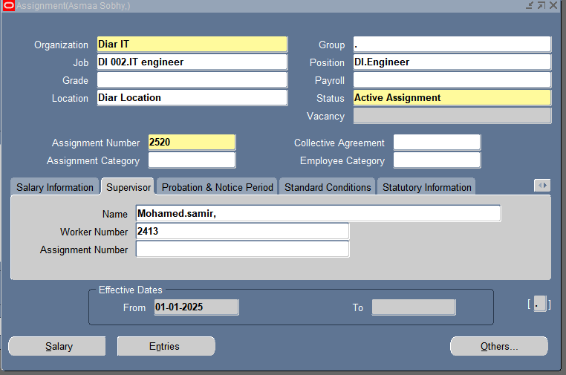
Define people and assign.
Global HRMS—people—enter and maintain

Slide 37
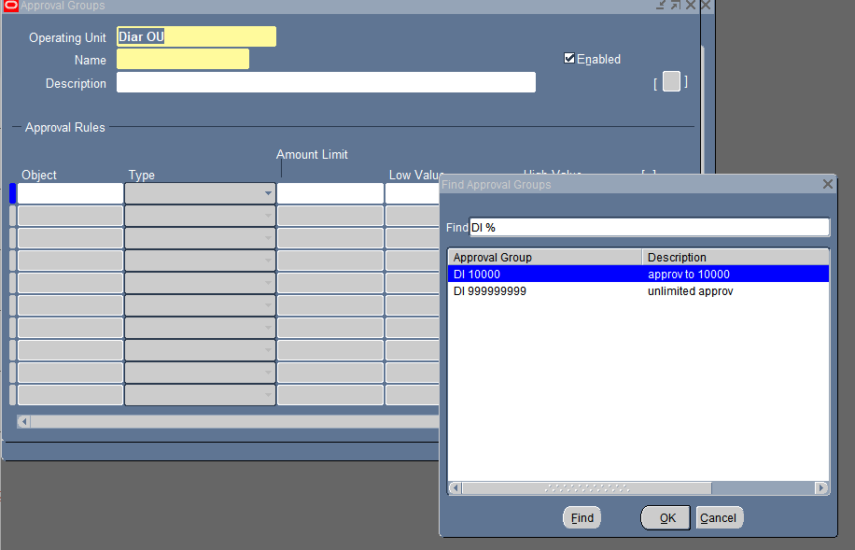
Approval groups and assign.
Diar purchasing– setup--approval

Slide 38
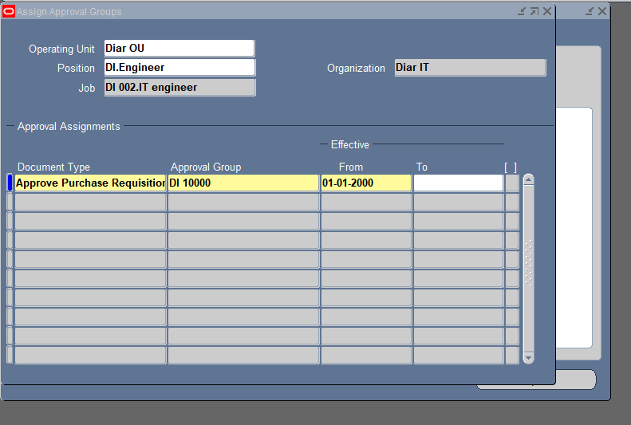
Approval groups and assign.
approval group
 | DI 10000 | approval to 10000
 | DI 999999999 | unlimited approve
Diar purchasing– setup--approval

Slide 39
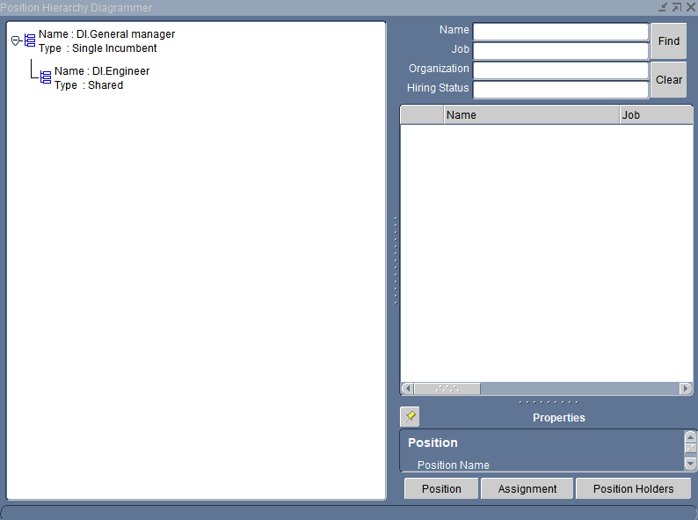
Define Position Hierarchy
position hirarcy | DI PHR
 | name | type | org. | job |  | date | NAME
 | DI.General manager | Single Incumbent | Diar IT | DI 001.IT manager |  | 1/1/2000 | Mohamed.samir
 | DI.Engineer | Shared | Diar IT | DI 002.IT engineer |  | 1/2/2000 | Asmaa Sobhy
Global HRMS—Work structure--position

Slide 40
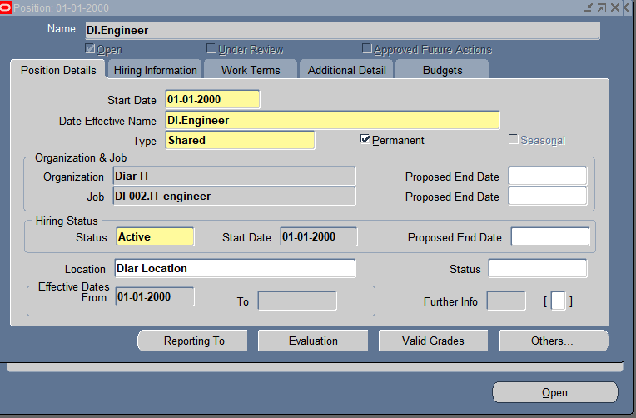
Define Position Hierarchy
position hirarcy | DI PHR
 | name | type | org. | job |  | date | NAME
 | DI.General manager | Single Incumbent | Diar IT | DI 001.IT manager |  | 1/1/2000 | Mohamed.samir
 | DI.Engineer | Shared | Diar IT | DI 002.IT engineer |  | 1/2/2000 | Asmaa Sobhy
Global HRMS—Work structure--position

Slide 41
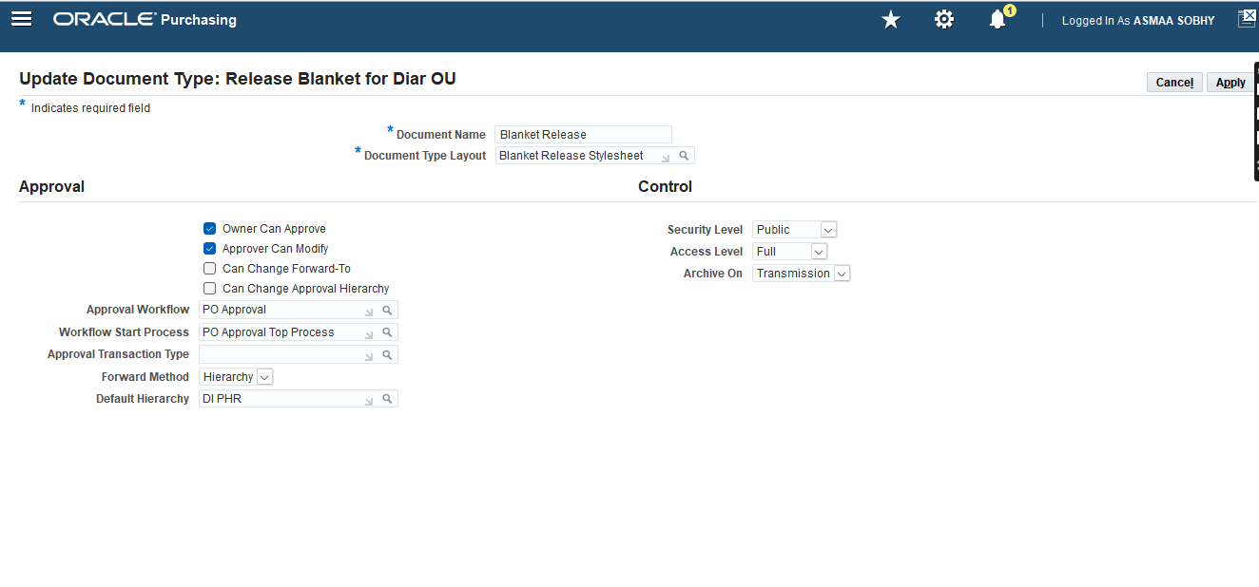
Assign HR TO DOCUMENT TYPE
DI PHR
Diar purchasing– setup—Purchasing—document type

Slide 42
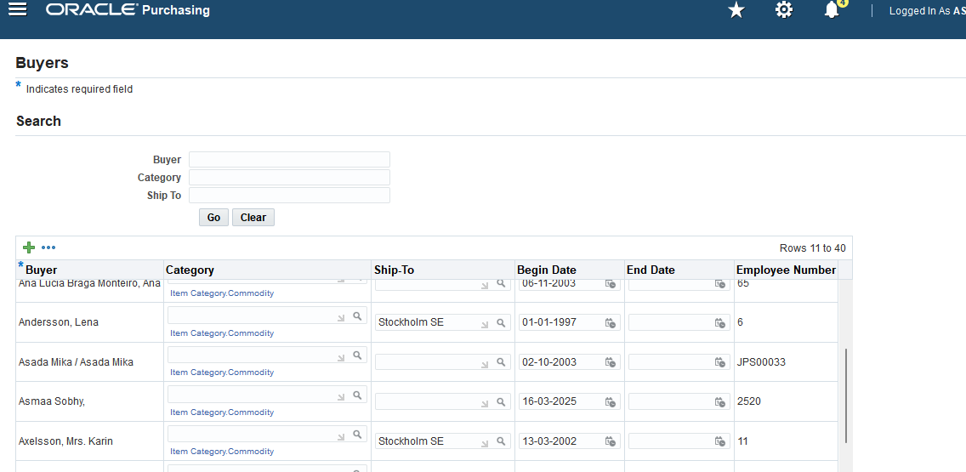
Define buyer
Diar purchasing– setup—personal---buyer

Slide 43
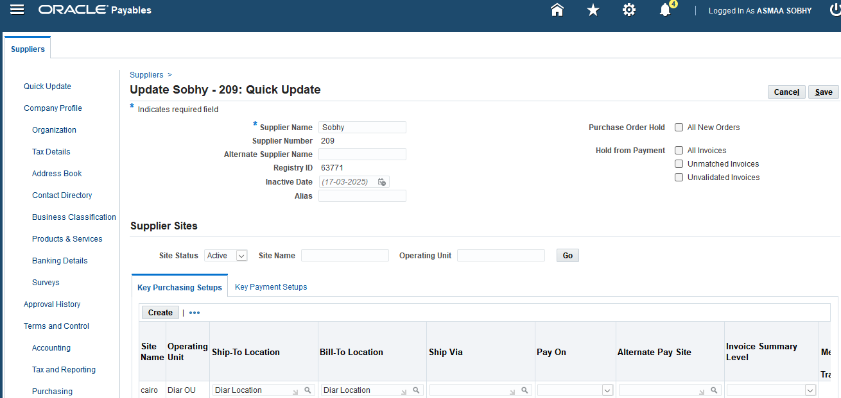
Define supplier
supplyer
 | name | no.
 | Sobhy | 209
Diar purchasing–SUPPLY BASE--supplier

Slide 44
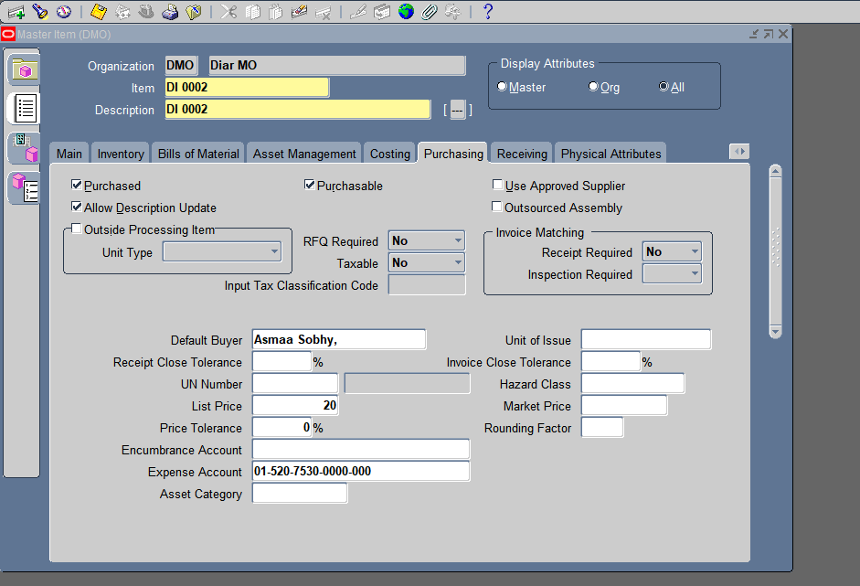
Define supplier/ Item With Default

Slide 45
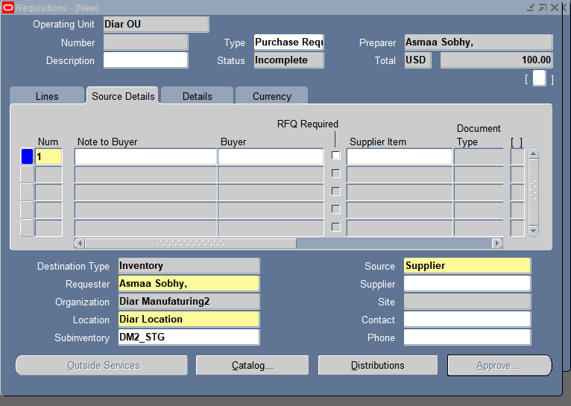
Requisition

Slide 46
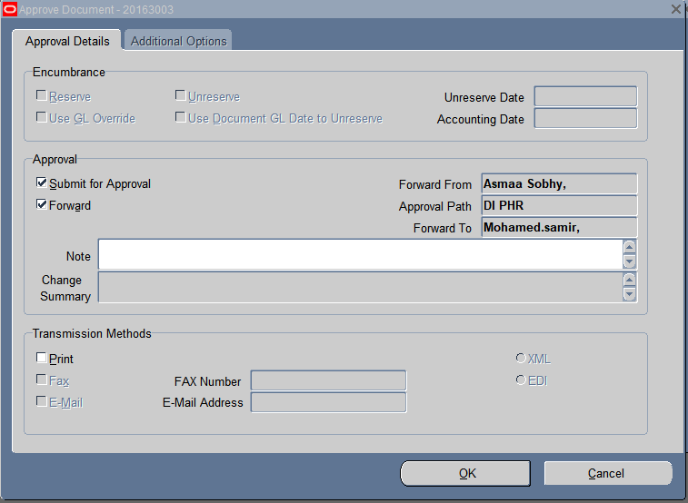
Requisition

Slide 47
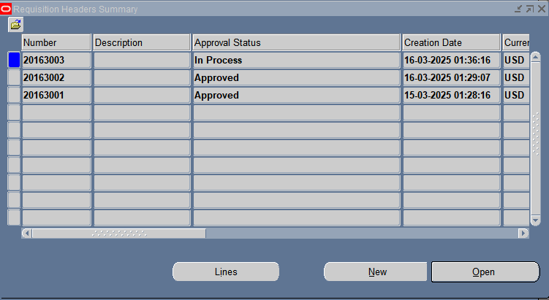
Requisition summary

Slide 48
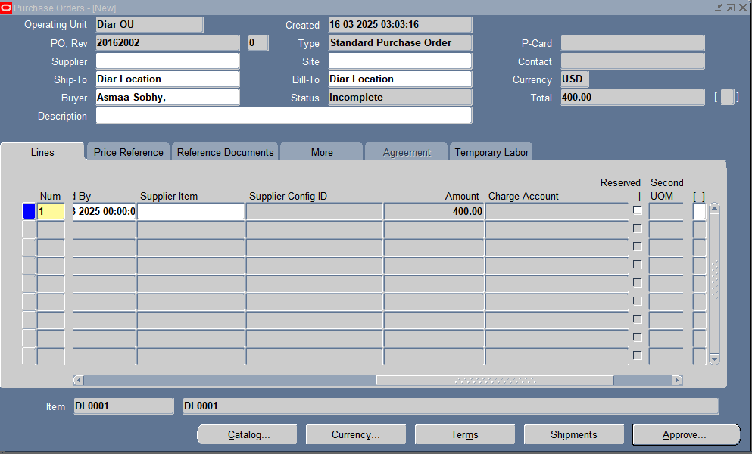
Purchase Order

Slide 49
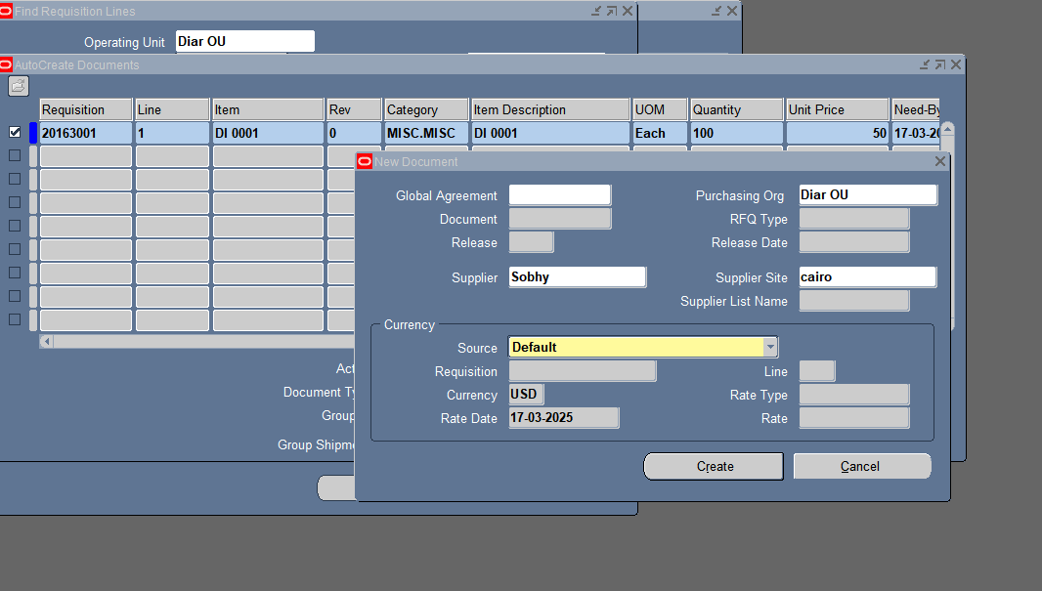
Auto create

Slide 50
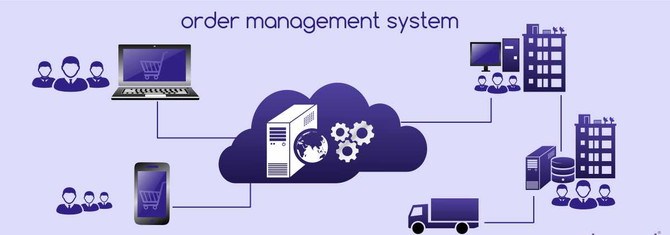
Order Management
^{3rd} phase of implementation

Slide 51

Create Responsibilities
How | System Administrator -– Security --- Responsibility --- Define
Name | Diar Order Management

Slide 52

Create Responsibilities
How | System Administrator -– Security --- Responsibility --- Define
Name | Diar Pricing Manager

Slide 53

Create Responsibilities
How | System Administrator -– Security --- Responsibility --- Define
Name | Diar Receivables Manager

Slide 54


Define System Parameters
Responsibility: | Diar Order Management
How | setup > system Parameters > Values
Generic Parameters
Customer Relationships
Customer Relationships (Service)
Item Validation Organization

Slide 55

Define System Parameters
Responsibility: | Diar Order Management
How | setup > system Parameters > Values
Invoicing Parameters
Over shipment Invoice Basis

Slide 56


Define Receivables
Manage Receivables System Options
Responsibility: | Receivables Manager
How | Setup > System > System options

Slide 57

Define Receivables
Open Accounting Period
Responsibility: | Receivables Manager
How | Control > Accounting > Open/Close periods

Slide 58

Define Receivables
Define Transaction Types
Responsibility: | Receivables Manager
How | Setup > Transactions > Transaction Types

Slide 59


Define Receivables
Define Transaction Sequence
Order Management > Setup > Documents > Define
Order Management > Setup > Documents > Assign

Slide 60

Define Receivables
Receivable Manager > Setup > Transactions >Auto Accounting
Define Auto Accounting

Slide 61



Manage Transaction Sources
Responsibility: | Receivables Manager
How | Setup > Transactions > Sources

Slide 62



Manage Transaction Sources 2

Slide 63

Define Customer Profile Classes
Responsibility: | Receivables Manager
How | Customers > Profile Classes

Slide 64



Remit-To Address Setup
Responsibility: | Receivables Manager
How | Setup > System > System Options

Slide 65


Define Customer
Responsibility: | Diar Order Management
How | Customers > Standard

Slide 66


Define Salesperson
Responsibility: | Diar Order Management
How | Setup > Sales > Sales Person

Slide 67



Shipping Parameters
Responsibility: | Diar Order Management
How | Shipping > Setup > Shipping Parameters

Slide 68



Define OM Transaction Type
Responsibility: | Diar Order Management
How | Setup > Transaction Types > Define

Slide 69


Define OM Transaction Sequence
Order Management > Setup > Documents > Define
Order Management > Setup > Documents > Assign

Slide 70


Create Sales Order
Responsibility: | Diar Order Management
How | Orders > Sales Orders

Slide 71


User Grant Rule
Setup > Shipping > Grants And Rule Definition > Define Grants
Setup > Shipping > Grants And Rule Definition > Grants

Slide 72



Shipping Transaction
Responsibility: | Diar Order Management
How | Shipping > Transactions

Slide 73



Transact Move Order
Inventory > Move Orders > Transact Move Orders (Allocate Then Transact)

Slide 74


Shipping Transaction Shipping Transaction
Shipping Transaction
Shipping > Transactions (Ship Confirm)

Slide 75

Create Master Item (Inventory > Items > Master Items)
Back-To-Back Cycle

Slide 76

Create Sourcing Rule (Purchasing > Supply Base > Sourcing Rule)
Back-To-Back Cycle

Slide 77

Back-To-Back Cycle
Assign Sourcing Rule (Purchasing > Supply Base > Assign Sourcing Rule)

Slide 78

Back-To-Back Cycle
Approved Supplier List (Purchasing > Supply Base > Approved Supplier List)

Slide 79

Back-To-Back Cycle
Blanket Purchase Agreement (Purchasing > Purchase Orders)

Slide 80


Back-To-Back Cycle
Sales Order (Order Management > Sales Orders)

Slide 81

Create Request From Purchasing (Purchasing > View > Requests) Requisition Import
Back-To-Back Cycle

Slide 82

Back-To-Back Cycle
Receiving Transactions (Inventory > Transactions > Receiving > Receipt)

